Slide 1
Various Heuristic Searches
Lecture Module 5

Slide 2
Heuristic Search
Heuristics are criteria for deciding which among several alternatives be the most effective in order to achieve some goal.
Heuristic is a technique that
  improves the efficiency of a search process possibly by sacrificing claims of systematicity and completeness.
  It no longer guarantees to find the best answer but almost always finds a very good answer.

Slide 3
Heuristic Search – Contd..
Using good heuristics, we can hope to get good solution to hard problems (such as travelling salesman) in less than exponential time.
There are general-purpose heuristics that are useful in a wide variety of problem domains.
We can also construct special purpose heuristics, which are domain specific.

Slide 4
General Purpose Heuristics
A general-purpose heuristics for combinatorial problem is
  Nearest neighbor algorithms which works by selecting the locally superior alternative.
  For such algorithms, it is often possible to prove an upper bound on the error which provide reassurance that one is not paying too high a price in accuracy for speed.
In many AI problems
  It is often hard to measure precisely the goodness of a particular solution.
  But still it is important to keep performance question in mind while designing algorithm.

Slide 5
Contd…
For real world problems
  It is often useful to introduce heuristics based on relatively unstructured knowledge.
  It is impossible to define this knowledge in such a way that mathematical analysis can be performed.
In AI approaches
  Behavior of algorithms are analyzed by running them on computer as contrast to analyzing algorithm mathematically.

Slide 6
Contd..
There are at least two reasons for the adhoc approaches in AI.
  It is a lot more fun to see a program do something intelligent than to prove it.
  AI problem domains are usually sufficiently complex, so generally not possible to produce analytical proof that a procedure will work.
  It is even not possible to describe the range of problems well enough to make statistical analysis of program behavior meaningful.

Slide 7
Contd..
One of the most important analysis of the search process is straightforward i.e.,
  Number of nodes in a complete search tree of depth D and branching factor F is F*D .
This simple analysis motivates to
  look for improvements on the exhaustive search.
  find an upper bound on the search time which can be compared with exhaustive search procedures.
HOW?

Slide 8
Informed Search Strategies- Branch & Bound Search
It expands the least-cost partial path. Sometimes, it is called uniform cost search.
Function g(X) assigns some cumulative expense to the path from Start node to X by applying the sequence of operators .
  For example, in salesman traveling problem, g(X) may be the actual distance from Start to current node X.
During search process there are many incomplete paths contending for further consideration.

Slide 9
Contd..
The shortest one is extended one level, creating as many new incomplete paths as there are branches.
These new paths along with old ones are sorted on the values of function g.
The shortest path is chosen and extended.
Since the shortest path is always chosen for extension, the path first reaching to the destination is certain to be nearly optimal.

Slide 10
Contd..
Termination Condition:
  Instead of terminating when a path is found, terminate when the shortest incomplete path is longer than the shortest complete path.
If g(X) = 1, for all operators, then it degenerates to simple Breadth-First search.
It is as bad as depth first and breadth first, from AI point of view,.
This can be improved if we augment it by dynamic programming i.e. delete those paths which are redundant.

Slide 11
Hill Climbing- (Quality Measurement turns DFS into Hill climbing (Variant of generate and test strategy)
Search efficiency may be improved if there is some way of ordering the choices so that the most promising node is explored first.
Moving through a tree of paths, hill climbing proceeds in
  depth-first order but the choices are ordered according to some heuristic value (i.e, measure of remaining cost from current to goal state).

Slide 12
Hill Climbing- Algorithm
Generate and Test Algorithm
Start
- Generate a possible solution
- Test to see, if it is goal.
- If not go to start else quit
End

Slide 13
Example of heuristic function
Straight line (as the crow flies) distance between two cities may be a heuristic measure of remaining distance in traveling salesman problem .

Slide 14
Simple Hill climbing : Algorithm
Store initially, the root node in a OPEN list (maintained as stack) ; Found = false;
While ( OPEN ≠ empty AND Found = false) Do
{
  Remove the top element from OPEN list and call it NODE;
  If NODE is the goal node, then Found = true else find SUCCs, of NODE, if any, and sort SUCCs by estimated cost from NODE to goal state and add them to the front of OPEN list.
} /* end while */
If Found = true then return Yes otherwise return No
Stop

Slide 15
Problems in hill climbing
There might be a position that is not a solution but from there no move improves situations?
This will happen if we have reached a Local maximum, a plateau or a ridge.
  Local maximum: It is a state that is better than all its neighbors but is not better than some other states farther away. All moves appear to be worse.
    Solution to this is to backtrack to some earlier state and try going in different direction.

Slide 16
Contd…
  Plateau: It is a flat area of the search space in which, a whole set of neighboring states have the same value. It is not possible to determine the best direction.
    Here make a big jump to some direction and try to get to new section of the search space.
  Ridge: It is an area of search space that is higher than surrounding areas, but that can not be traversed by single moves in any one direction. (Special kind of local maxima).
    Here apply two or more rules before doing the test i.e., moving in several directions at once.

Slide 17
Beam Search
Beam Search progresses level by level.
It moves downward from the best W nodes only at each level. Other nodes are ignored.
  W is called width of beam search.
It is like a BFS where also expansion is level wise.
Best nodes are decided on the heuristic cost associated with the node.
If B is the branching factor, then there will be only W*B nodes under consideration at any depth but only W nodes will be selected.

Slide 18
Algorithm – Beam search
Found = false;
NODE = Root_node;
If NODE is the goal node, then Found = true else find SUCCs of NODE, if any with its estimated cost and store in OPEN list;
While (Found = false)
{
  Sort OPEN list;
  Select top W elements from OPEN list and put it in W_OPEN list and empty OPEN list;

Slide 19
Algorithm – Contd…
  While (W_OPEN ≠ φ AND Found = false)
{
    Get NODE from W_OPEN;
    If NODE = Goal state then Found = true else
    {
      Find SUCCs of NODE, if any with its estimated cost
      store in OPEN list;
}
} // end while
} // end while
If Found = true then return Yes otherwise return No and Stop

Slide 20
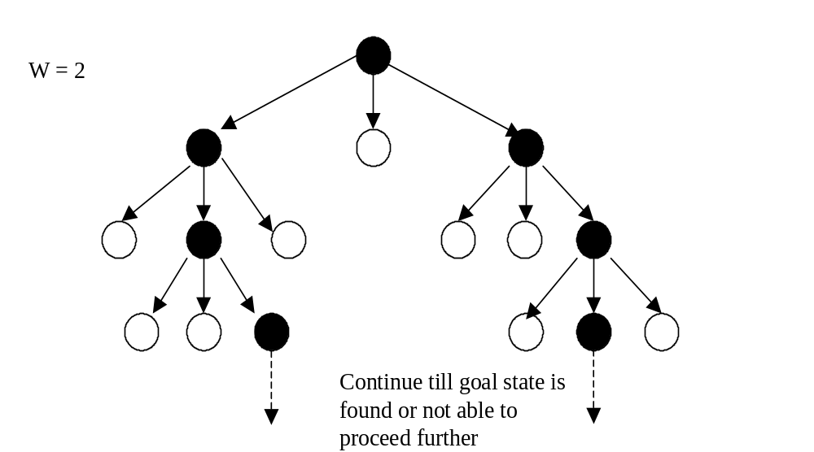

Slide 21
Best First Search
Expand the best partial path.
Here forward motion is carried out from the best open node so far in the entire partially developed tree.

Slide 22
Algorithm (Best First Search)
Initialize OPEN list by root node; CLOSED = φ;
Found = false;
While (OPEN ≠ φ AND Found = false) Do
{
  If the first element is the goal node, then Found = true else remove it from OPEN list and put it in CLOSED list.
  Add its successor, if any, in OPEN list.
  Sort the entire list by the value of some heuristic function that assigns to each node, the estimate to reach to the goal node
} /* end while */
If the Found = true, then announce the success else announce failure.
Stop.

Slide 23
Observations
In hill climbing, sorting is done on the successors nodes whereas in the best first search sorting is done on the entire list.
It is not guaranteed to find an optimal solution, but normally it finds some solution faster than any other methods.
The performance varies directly with the accuracy of the heuristic evaluation function.

Slide 24
Termination Condition
Instead of terminating when a path is found, terminate when the shortest incomplete path is longer than the shortest complete path.

Slide 25
A* Method
A* (“Aystar”) (Hart, 1972) method is a combination of branch & bound and best search, combined with the dynamic programming principle.
The heuristic function (or Evaluation function) for a node N is defined as f(N) = g(N) + h(N)
The function g is a measure of the cost of getting from the Start node (initial state) to the current node.
  It is sum of costs of applying the rules that were applied along the best path to the current node.
The function h is an estimate of additional cost of getting from the current node to the Goal node (final state).
  Here knowledge about the problem domain is exploited.
A* algorithm is called OR graph / tree search algorithm.

Slide 26
Algorithm (A*)
Initialization OPEN list with initial node; CLOSED= φ; g = 0, f = h, Found = false;
While (OPEN ≠ φ and Found = false )
{¹
  Remove the node with the lowest value of f from OPEN to CLOSED and call it as a Best_Node.
  If Best_Node = Goal state then Found = true else
  {²
    Generate the Succ of Best_Node
    For each Succ do
    {³
      Compute g(Succ) = g(Best_Node) + cost of getting from Best_Node to Succ.

Slide 27
A* - Contd..
      If Succ ∈ OPEN then /* already being generated but not processed */
    {⁴
        Call the matched node as OLD and add it in the list of Best_Node successors.
        Ignore the Succ node and change the parent of OLD, if required.
        - If g(Succ) < g(OLD) then make parent of OLD to be Best_Node and change the values of g and f for OLD
        - If g(Succ) >= g(OLD) then ignore
      }⁴

Slide 28
A* - Contd..
      If Succ ∈ CLOSED then /* already processed */
      {⁵
        Call the matched node as OLD and add it in the list of Best_Node successors.
        Ignore the Succ node and change the parent of OLD, if required
        - If g(Succ) < g(OLD) then make parent of OLD to be Best_Node and change the values of g and f for OLD.
        - Propogate the change to OLD’s children using depth first search
        - If g(Succ) >= g(OLD) then do nothing
      }⁵

Slide 29
A* - Contd..
      If Succ ∉ OPEN or CLOSED
      {⁶
        Add it to the list of Best_Node’s successors
        Compute f(Succ) = g(Succ) + h(Succ)
        Put Succ on OPEN list with its f value
      }⁶
}³ /* for loop*/
}² /* else if */
}¹ /* End while */
If Found = true then report the best path else report failure
Stop

Slide 30
Behavior of A* Algorithm
Underestimation
If we can guarantee that h never over estimates actual value from current to goal, then A* algorithm is guaranteed to find an optimal path to a goal, if one exists.

Slide 31
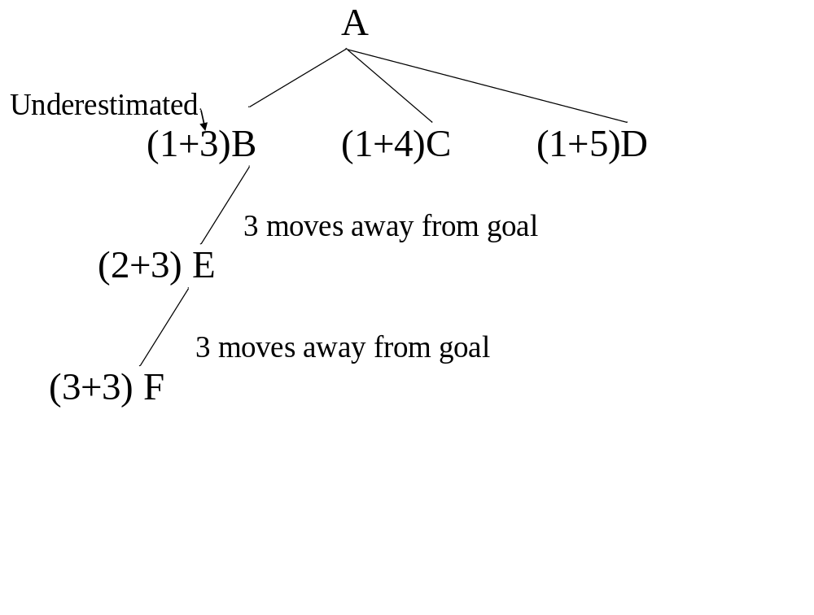
Example – Underestimation – f=g+h
Here h is underestimated

Slide 32
Explanation -Example of Underestimation
Assume the cost of all arcs to be 1. A is expanded to B, C and D.
‘f’ values for each node is computed.
B is chosen to be expanded to E.
We notice that f(E) = f(C) = 5
Suppose we resolve in favor of E, the path currently we are expanding. E is expanded to F.
Clearly expansion of a node F is stopped as f(F)=6 and so we will now expand C.
Thus we see that by underestimating h(B), we have wasted some effort but eventually discovered that B was farther away than we thought.
Then we go back and try another path, and will find optimal path.

Slide 33
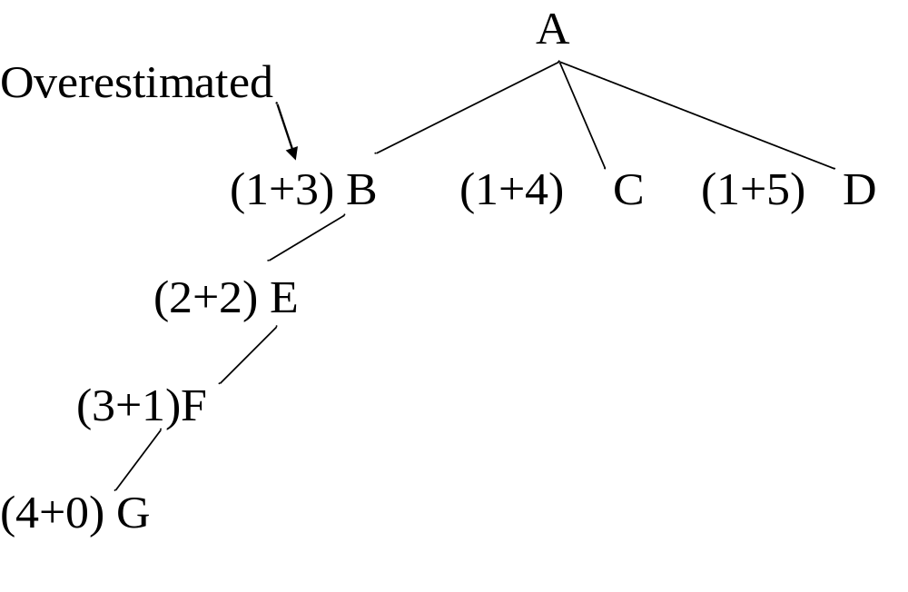
Example – Overestimation
Here h is overestimated

Slide 34
Explanation –Example of Overestimation
A is expanded to B, C and D.
Now B is expanded to E, E to F and F to G for a solution path of length 4.
Consider a scenario when there a direct path from D to G with a solution giving a path of length 2.
We will never find it because of overestimating h(D).
Thus, we may find some other worse solution without ever expanding D.
So by overestimating h, we can not be guaranteed to find the cheaper path solution.

Slide 35
Admissibility of A*
A search algorithm is admissible, if
  for any graph, it always terminates in an optimal path from initial state to goal state, if path exists.
If heuristic function h is underestimate of actual value from current state to goal state, then the it is called admissible function.
Alternatively we can say that A* always terminates with the optimal path in case
  h(x) is an admissible heuristic function.

Slide 36
Monotonicity
A heuristic function h is monotone if
  ∀ states Xi and Xj such that Xj is successor of Xi
h(Xi)– h(Xj) ≤ cost (Xi, Xj)
where, cost (Xi, Xj) actual cost of going from Xi to Xj
  h (goal) = 0
In this case, heuristic is locally admissible i.e., consistently finds the minimal path to each state they encounter in the search.

Slide 37
Contd..
Alternatively, the monotone property:
  that search space which is every where locally consistent with heuristic function employed i.e., reaching each state along the shortest path from its ancestors.
With monotonic heuristic, if a state is rediscovered, it is not necessary to check whether the new path is shorter.
Each monotonic heuristic is admissible
  A cost function f(n) is monotone, if f(n) ≤f(succ(n)), ∀n.
For any admissible cost function f, we can construct a monotone admissible function.

Slide 38
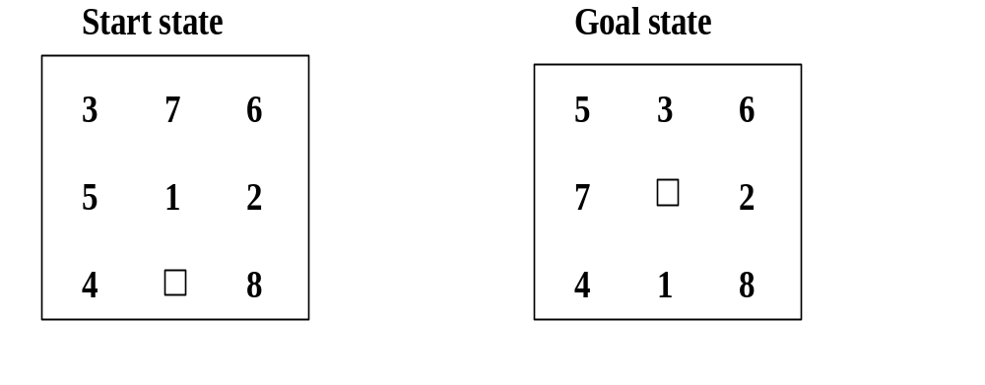
Example: Eight puzzle problem

Slide 39
Evaluation function - f for EPP
The choice of evaluation function critically determines search results.
Consider Evaluation function
f (X) = g (X) + h(X)
  h (X) = the number of tiles not in their goal position in a given state X
  g(X) = depth of node X in the search tree
For Initial node
  f(initial_node) = 4
Apply A* algorithm to solve it.

Slide 40
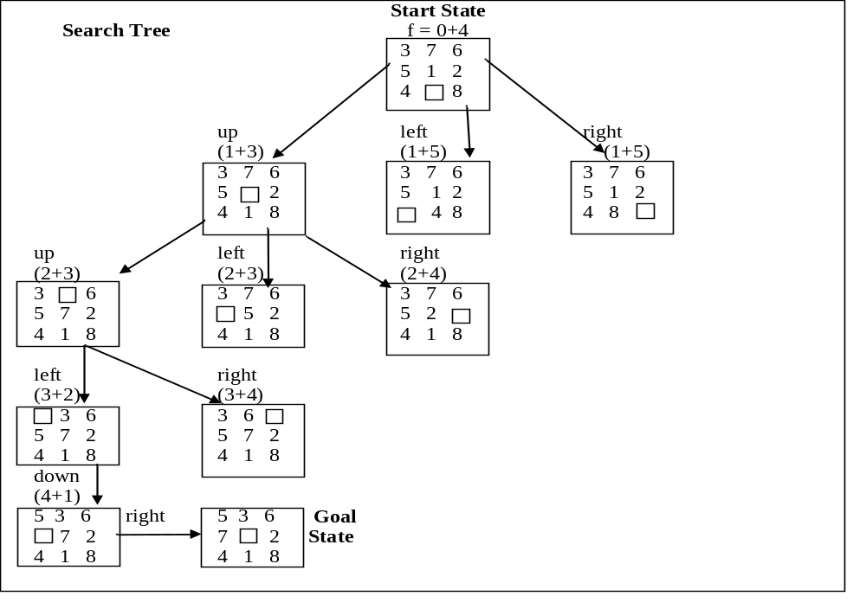

Slide 41
Harder Problem
Harder problems (8 puzzle) can’t be solved by heuristic function defined earlier.
Initial State Goal State
1 6 1 2 3
4 8 8 4
7 5 3 7 6 5
A better estimate function is to be thought.
h (X) = the sum of the distances of the tiles from their goal position in a given state X
Initial node has h(initial_node) = 1+1+2+2+1+3+0+2=12

Slide 42
IDA* Algorithm
At each iteration, perform a DFS cutting off a branch when its total cost (g+h) exceeds a given threshold.
This threshold starts at the estimate of the cost of the initial state, and increases for each iteration of the algorithm.
At each iteration, the threshold used for the next iteration is the minimum cost of all values exceeded the current threshold.

Slide 43
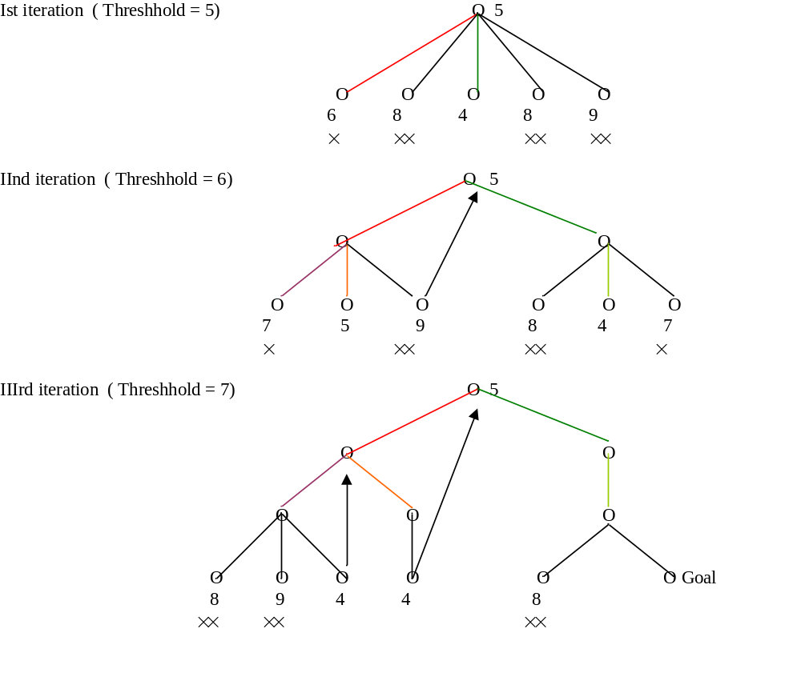

Slide 44
Contd..
Given an admissible monotone cost function, IDA* will find a solution of least cost or optimal solution if one exists.
IDA* not only finds cheapest path to a solution but uses far less space than A* and it expands approximately the same number of nodes as A* in a tree search.
An additional benefit of IDA* over A* is that it is simpler to implement, as there are no open and closed lists to be maintained.
A simple recursion performs DFS inside an outer loop to handle iterations.

